Slide 1
Chapter 17
Parallel Processing

Slide 2
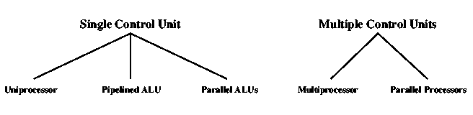
Computer Organizations

Slide 3
Multiple Processor Organization
Single instruction, single data stream – SISD
Single instruction, multiple data stream – SIMD
Multiple instruction, single data stream – MISD
Multiple instruction, multiple data stream- MIMD

Slide 4
Single Instruction, Single Data Stream - SISD
Single processor
Single instruction stream
Data stored in single memory

Slide 5
Single Instruction, Multiple Data Stream - SIMD
Single machine instruction
  Each instruction executed on different set of data by different processors
Number of processing elements
  Machine controls simultaneous execution
    Lockstep basis
  Each processing element has associated data memory
Application: Vector and array processing

Slide 6
Multiple Instruction, Single Data Stream - MISD
Sequence of data
Transmitted to set of processors
Each processor executes different instruction sequence
Not clear if it has ever been implemented

Slide 7
Multiple Instruction, Multiple Data Stream- MIMD
Set of processors
Simultaneously executes different instruction sequences
Different sets of data
Examples: SMPs, NUMA systems, and Clusters

Slide 8
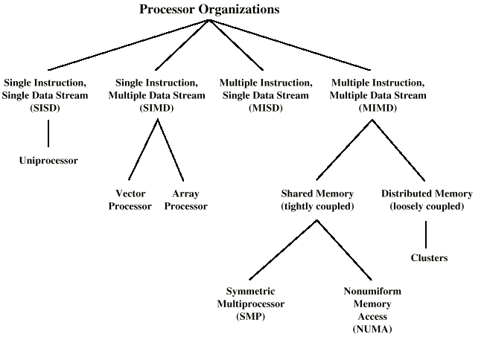
Taxonomy of Parallel Processor Architectures

Slide 9
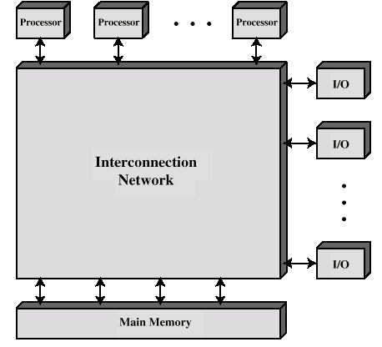
Block Diagram of Tightly Coupled Multiprocessor
Processors share memory
Communicate via that shared memory

Slide 10
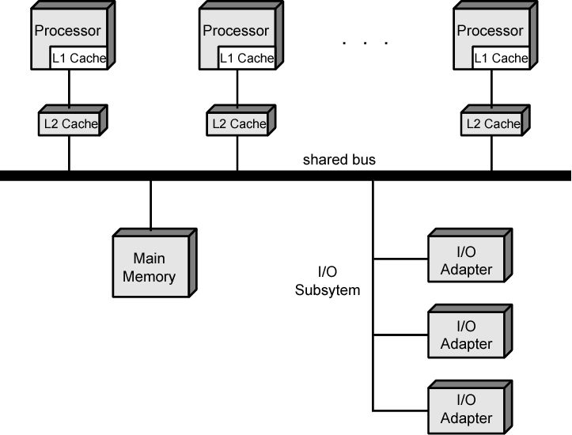
Symmetric Multiprocessor Organization

Slide 11
Symmetric Multiprocessors
A stand alone computer with the following characteristics
  Two or more similar processors of comparable capacity
  Processors share same memory and I/O
  Processors are connected by a bus or other internal connection
  Memory access time is approximately the same for each processor
  All processors share access to I/O
    Either through same channels or different channels giving paths to same devices
  All processors can perform the same functions (hence symmetric)
  System controlled by integrated operating system
    providing interaction between processors
    Interaction at job, task, file and data element levels

Slide 12
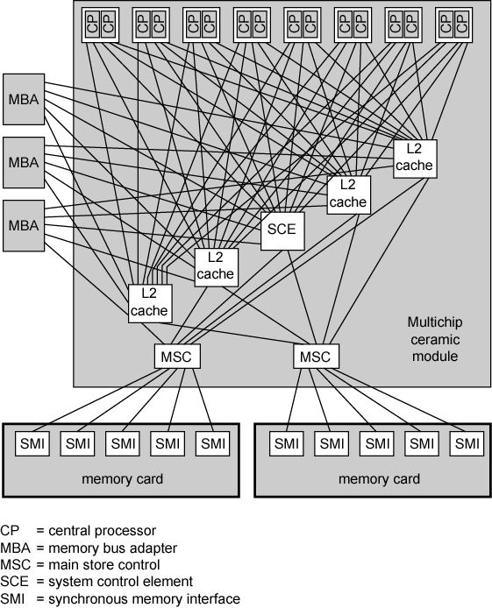
IBM z990
Multiprocessor
Structure

Slide 13
SMP Advantages
Performance
  If some work can be done in parallel
Availability
  Since all processors can perform the same functions, failure of a single processor does not halt the system
Incremental growth
  User can enhance performance by adding additional processors
Scaling
  Vendors can offer range of products based on number of processors

Slide 14
Cache Coherence Problems
Popular solution - Snoopy Protocol
Distribute cache coherence responsibility among cache controllers
Cache recognizes that a line is shared
Updates announced to other caches

Slide 15
Loosely Coupled - Clusters
Collection of independent whole uniprocessors or SMPs
  Usually called nodes
Interconnected to form a cluster
Working together as unified resource
  Illusion of being one machine
Communication via fixed path or network connections

Slide 16
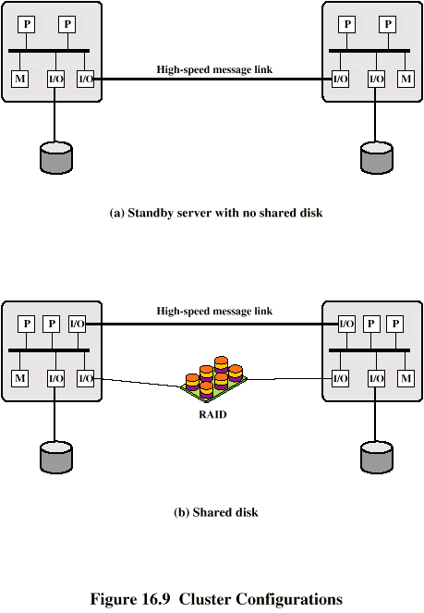
Cluster Configurations

Slide 17
Cluster Benefits
Absolute scalability
Incremental scalability
High availability
Superior price/performance

Slide 18
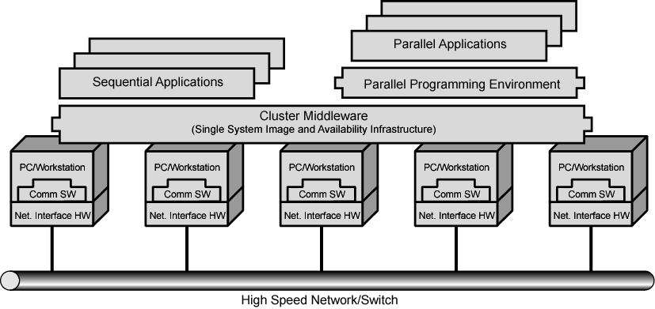
Cluster Computer Architecture

Slide 19
Cluster v. SMP
Both provide multiprocessor support to high demand applications.
Both available commercially
SMP:
  Easier to manage and control
  Closer to single processor systems
    Scheduling is main difference
    Less physical space
    Lower power consumption
Clustering:
  Superior incremental & absolute scalability
  Less cost
  Superior availability
    Redundancy

Slide 20
Nonuniform Memory Access (NUMA)
(Tightly coupled)
Alternative to SMP & Clusters
Nonuniform memory access
  All processors have access to all parts of memory
    Using load & store
  Access time of processor differs depending on region of memory
    Different processors access different regions of memory at different speeds
Cache coherent NUMA ?
  Cache coherence is maintained among the caches of the various processors
  Significantly different from SMP and Clusters

Slide 21
Motivation
SMP has practical limit to number of processors
  Bus traffic limits to between 16 and 64 processors
In clusters each node has own memory
  Apps do not see large global memory
  Coherence maintained by software not hardware
NUMA retains SMP flavour while giving large scale multiprocessing
Objective is to maintain transparent system wide memory while permitting multiprocessor nodes, each with own bus or internal interconnection system

Slide 22
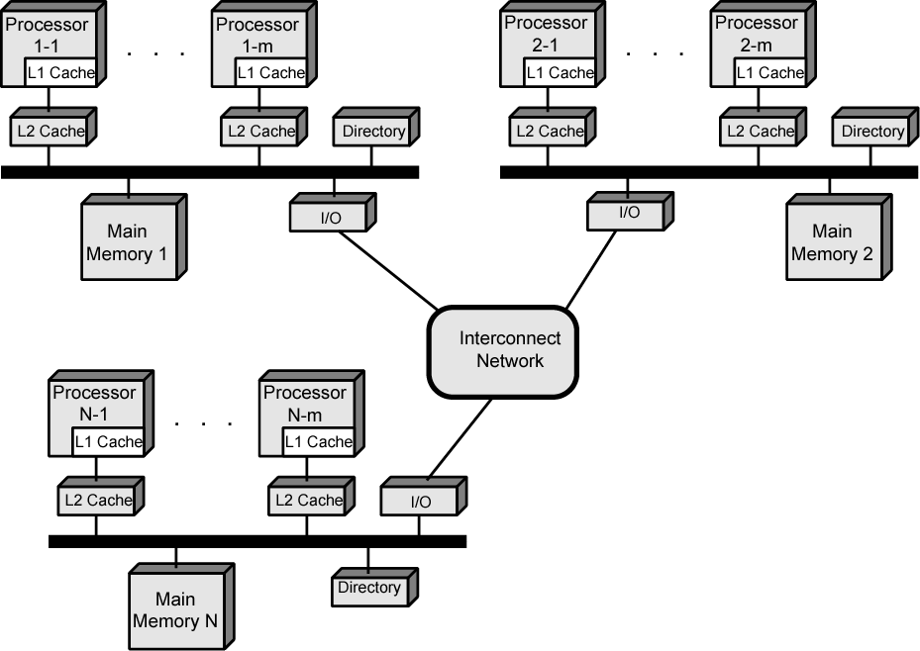
CC-NUMA Organization

Slide 23
NUMA Pros & Cons
Possibly effective performance at higher levels of parallelism than one SMP
Not very supportive of software changes
Performance can breakdown if too much access to remote memory
  Can be avoided by:
    L1 & L2 cache design reducing all memory access
      Need good temporal locality of software
Not transparent
  Page allocation, process allocation and load balancing changes can be difficult
Availability?

